Slide 1
NextHikes IT Solutions GUI Python Calculator Project Using Tkinter
- Presented by Parul Srivastava

Slide 2
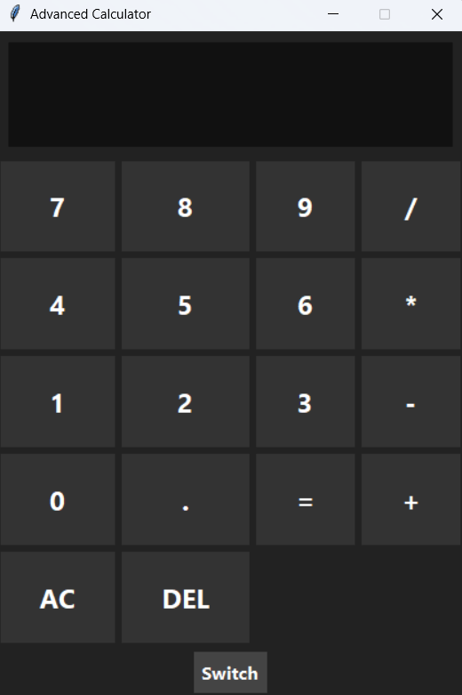
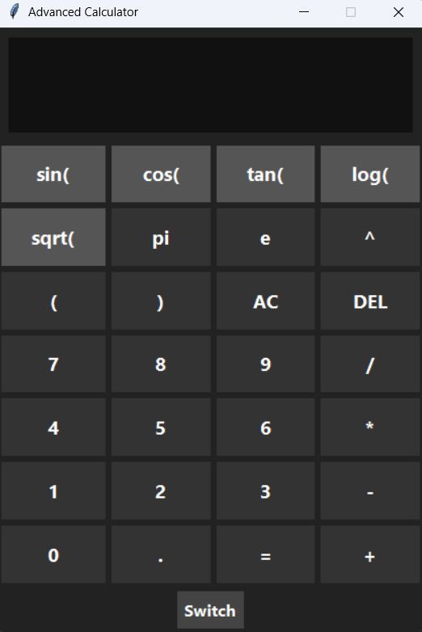
GUI Python Calculator – Basic & Scientific with Mode Switch

Slide 3
Overview of the Project
• Build Python-based GUI Calculator using Tkinter, math libraries in Visual Studio
• Created Switch button to toggle between Basic and Scientific modes of the calculator. Keeping users in mind, I have input everything in one specific application so that the users don’t need to switch around multiple resources to calculate certain things.
• Organized using Object-Oriented Programming (OOP)
• Supports scientific functions like sin(, cos(, tan(, log(, sqrt(, pi (π), e
• Includes AC (All Clear), DEL (Delete) buttons, Evaluate button (=), and responsive display box
• Tkinter library is used because it comes pre-installed with most python distributions, making it convenient for beginners & quick project development. It offers a relatively straightforward and intuitive API for creating widgets like buttons, entry fields, and labels.

Slide 4
Key Features of Advanced Calculator
Basic Calculator Mode
Scientific Calculator Mode
Includes:
• Digits: 0–9
• Operators: +, -, *, /
• Decimal point
• Equal button (=)
• AC (clear screen)
• DEL (deletes one character at a time)
'=' evaluates using Python eval()
• Errors (invalid expressions) return 'Error'
This mode loads by default
Additional functions:
• Trigonometry: sin, cos, tan
• Logarithmic: log
• Constants: pi (π), e
• Operators: %, (), √, power(^)
Uses math library for advanced evaluation.
Algebraic expressions
User inputs build a string expression

Slide 5
Benefits of Python GUI Advanced Calculator vs Website Calculators
Feature | Python GUI Advanced Calculator | Website Calculator
Internet Requirement | ❌ No internet needed; fully offline | 🌐 Requires internet or browser loading
Speed & Performance | ⚡ Very fast (local execution) | ⏳ Depends on browser speed & network
User Interface | 🧭 Clean, distraction-free | 📢 Often ads, pop-ups, clutter
Mode Switching (Basic ↔ Scientific) | ✔️ One-click toggle inside the app | ❌ Usually separate pages or complex menus
Theme Options (Light/Dark) | ✔️ Customizable themes | ❌ Mostly fixed theme, limited options
Customization | 🎛️ Fully customizable (add features) | ❌ Not customizable by users
Privacy | 🔒 100% private, no tracking | ⚠️ May track usage, cookies, analytics
Accessibility | 🔍 Adjustable UI, big buttons, shortcuts | ♿ Limited accessibility; fixed layout
Performance Stability | 🚀 Consistent across all computers | 🔄 Varies by browser & device
Offline Availability | ✔️ Always available | ❌ Not usable without browser/internet
Educational Value | 📘 Helps learn Python, UI, logic | ❌ No educational value
Design Flexibility | 🎨 Fully editable source code | 🚫 Cannot modify website UI
Memory & History | ✔️ Easily add history panel | ❌ Not available on most sites
Security | 🔐 No external vulnerabilities | 🌍 Browser-based risks possible

Slide 6
Key Challenges & Solutions
Dynamic Interface Management: The primary challenge is dynamically showing or hiding the extra scientific buttons (sin, cos, etc.) without overlapping existing elements or requiring a fixed window size.
Handling: This is best managed using layout managers like grid() in Tkinter, grouping basic and scientific buttons into separate Frames. The scientific frame can be hidden or shown instantly using methods such as grid_remove() or grid() when the mode switch is toggled.
Mathematical Logic and Error Handling: Implementing advanced operations while correctly maintaining the order of operations (PEMDAS/BODMAS) and preventing crashes from invalid inputs (e.g., dividing by zero or logarithm of a negative number) is complex.
Handling: The use of Python's secure expression parsers (or careful handling with eval() after strict input sanitization) can manage the order of operations. Robust try-except blocks must be wrapped around all mathematical evaluations to catch and display user-friendly "Error" messages instead of crashing the program.
Code Structure and Maintainability: As functions increase, the code can quickly become unmanageable with repetitive logic and tangled function calls.
Handling: Applying Object-Oriented Programming (OOP) principles to structure the code into logical components (e.g., a UI class and a Logic class) ensures maintainability. Centralizing button handling into a single, generic function also reduces redundancy and keeps the codebase clean.

Slide 7
References:
Tkinter (Python GUI) Official Docs
https://docs.python.org/3/library/tkinter.html
Source of all Tkinter widget descriptions (Buttons, Frames, Entry, Layout, etc.)
Python Math Library Docs
https://docs.python.org/3/library/math.html
Basis for scientific functions (sin, cos, log, sqrt…).
TkDocs – Tkinter Tutorial
https://tkdocs.com/tutorial/index.html
A highly reliable step-by-step guide for beginners & advanced GUI designing.
Real Python – Tkinter Guide
https://realpython.com/python-gui-tkinter/
Used for event handling, widget placement, and command binding.
GeeksforGeeks – Calculator using Tkinter
https://www.geeksforgeeks.org/python-simple-gui-calculator-using-tkinter/
TutorialsPoint – Tkinter Calculator Examples
https://www.tutorialspoint.com/python/python_gui_programming.htm

Slide 8
Thank You…

